Slide 1
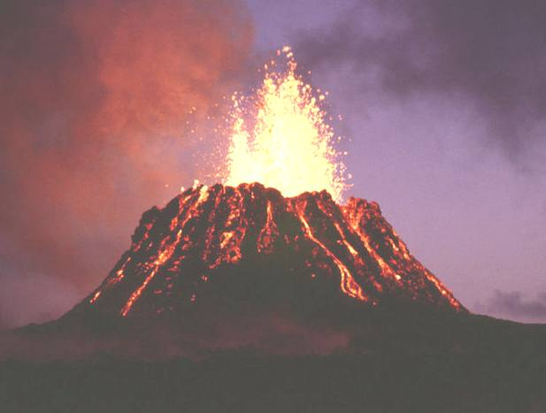
Volcanoes
A volcano is an opening in the Earth’s crust through which molten rock, rock fragments, and hot gases erupt.

Slide 2
Volcanoes erupt many types of materials:
Magma
Rock Fragments
Volcanic Gases (Mixture of Water Vapor , Carbon Dioxide, and ashes)
Pyroclastic Flow – Mixture of gases and rock fragments that form a dense cloud.

Slide 3
Magma and Lava
Magma is molten rock BENEATH the Earth’s surface. When magma erupts, it is called lava.
Lava is molten rock, or magma that reaches the Earth’s surface through a volcano.

Slide 4
Magma Chambers
Magma collects in areas called “magma chambers’.
Volcanic eruptions occur when a chamber is not large enough to hold additional magma that pushes in.
Magma can remain in a chamber until it cools, forming igneous rock, or it can erupt in the form of lava.

Slide 5
Rock Fragments
Volcanic Ash – These are tiny rock fragments ranging from the size of dust to about the size of rice grains.
Volcanic Cinders – These are much larger as compared to volcanic ash.
Volcanic Bombs and Blocks – These are the largest fragments. Bombs are molten when they are thrown out and often have streamlined shapes. Blocks can be the size of houses and erupt as solid pieces of rock.

Slide 6
Rock Fragments

Slide 7
Volcanic Gases
Volcanic gases look like smoke rising from the volcano. They are a mixture of ash and gases namely, carbon dioxide. Some volcanic gases combine with water in the air to form acids.

Slide 8
Pyroclastic Flows
Sometimes volcanic gases can mix with rock fragments forming a pyroclastic flow. This is a dense cloud of superhot gases and rock fragments that races downhill. It can be as hot as 800°C (1500°F) and can travel faster than 160 kilometers per hour (100 mi/h). Pyroclastic flows are the most dangerous type of volcanic eruption.

Slide 9
Formation of Volcanoes:
Volcanoes are common along tectonic plate boundaries where oceanic plates sink beneath other plates.
Volcanoes are also common along tectonic boundaries where plates pull apart, allowing magma to rise from the mantle.
Occasionally, volcanoes are formed over a hot spot far from a plate boundary.

Slide 10
Types of Volcanoes:
Shield Volcano
Cinder Cone
Composite Volcano

Slide 11
Shield Volcano :
A shield volcano is built from many eruptions of lava that is low in silica and flows easily. It is a broad flat dome.
Example - Mauna Loa shield volcano

Slide 12
Cinder Cone:
A cinder cone is a steep, cone-shaped hill. It is built of pieces of magma that harden in the air and fall to form a small, steep-sided volcano.

Slide 13
Composite Volcano:
A composite volcano is a cone-shaped volcano built of high-silica magma. The tall cone consists of layers of lava and layers of rock fragments.

Slide 14
Volcanoes and their effects -
Volcanic eruptions can knock down forests and destroy homes by flowing into the homes or by starting fires.
Volcanic eruptions can clog rivers.
Some volcanic gases combine with water in the air to form acids.
Many volcanic gases are dangerous. They can make breathing difficult and damage the lungs of people and animals.
In West Africa, a sudden release of carbon dioxide from a volcano at the bottom of a lake killed 1700 people in 1986.

Slide 15
Immediate Effects of Volcanoes:
Lava Flows
Volcanic Ash
Mudflows
Pyroclastic flows
Landslides

Slide 16
Lava Flows -
Most lava moves too slow to hurt people. However it can knock down, cover, or burn nearly everything in its path.

Slide 17
Volcanic Ash -
The weight of fallen volcanic ash can cause the roofs of buildings to collapse.
Ash makes roads slippery, and it clogs up machinery, including cars and airplanes.
Large amounts of falling ash can suffocate plants, animals, and people.

Slide 18
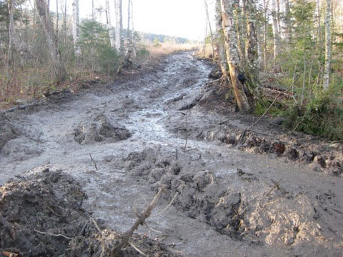
Mudflows -
Mudflows are landslides that occur when loose rocks and soil are mixed with water.
Mudflows also form as ash mixes into rivers flowing from a volcano.
Fast-moving mudflows can bury entire towns tens of kilometers from an eruption.

Slide 19
Pyroclastic flows -
In 1902, a pyroclastic flow from an eruption in the West Indies completely destroyed the city of Saint Pierre. Almost 30,000 people were killed within a few minutes.

Slide 20
Landslides -
Part of a volcano can collapse and start a landslide. The collapse may be caused by an eruption, an earthquake, or even heavy rainfall. A landslide can cause a tsunami if a large amount of material falls into the ocean.

Slide 21
Steam Explosions -
Steam explosions occur when magma comes into contact with water. The entire island of Krakatau exploded in 1883, causing a tsunami that destroyed hundreds of towns and killed more than 36,000 people. Steam explosions can be devastating.

Slide 22
Long-Term Effects of Volcanoes:
Volcanoes build as well as destroy. Material erupted from volcanoes can form new land. Over time, lava flows can form new, rich soil.
Repeated volcanic eruptions can build a magnificent landscape of mountains and valleys.
People live in a volcanic area for its natural beauty or there might be a flourishing tourist industry.

Slide 23
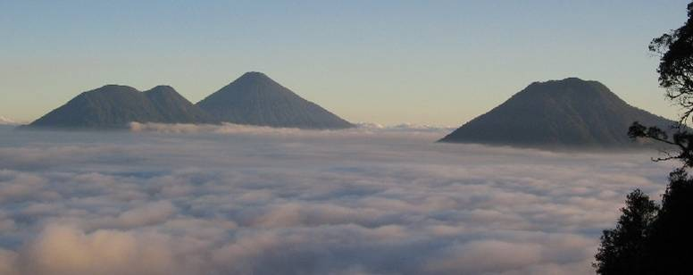
Landscape of Mountains and Valleys

Slide 24
Formation of Volcanic Islands

Slide 25
Questions!!!!!!!!!!
Answer the following questions -
What are volcanoes?
What are the three kinds of volcanoes?
What is the difference between “magma” and “lava”?
What are the effects of volcanoes on Earth’s land, water, and air?

