Slide 1
Equations and Inequalities
Part 1: Expressions vs Equations and Inequalities
Essential Question:
What is an equation and how is it similar and/or
different from an expression?

Slide 2
Which of the following can be identified as an equation?
3x + 7 – 27
35 – w ≥ 7
4 + 2 = 6
9 < 10

Slide 3
Think. Pair. Share
3 + x + 2
Is the item above an expression, an equation or an inequality?
Is it possible to determine the value of x? Why or why not?
What other information would you need in order to determine the value of x?

Slide 4
Think. Pair. Share.
3 + x + 2 = 9
Can you now determine the value of x?
What changed?

Slide 5
Think. Pair. Share.
3 + x + 2 < 9
What about now?
Can you determine the value(s) of x?
What is different this time?

Slide 6
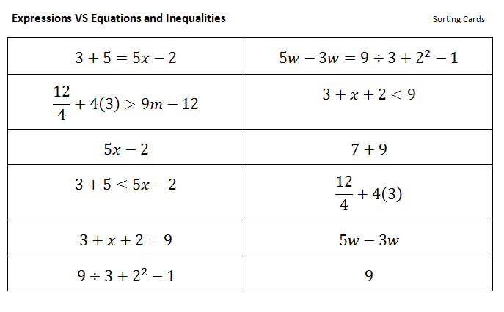
Sorting Activity
Look at the following items carefully. With your group decide how you would group the items if you had to separate them into three different categories.

Slide 7
Discovery Education Video
https://www.youtube.com/watch?v=jRHoXoqCL80
While you watch the video try to determine if your three categories for the sorting activity are correct.
After viewing the video, decide with your group if you should rearrange your items into different categories.

Slide 8
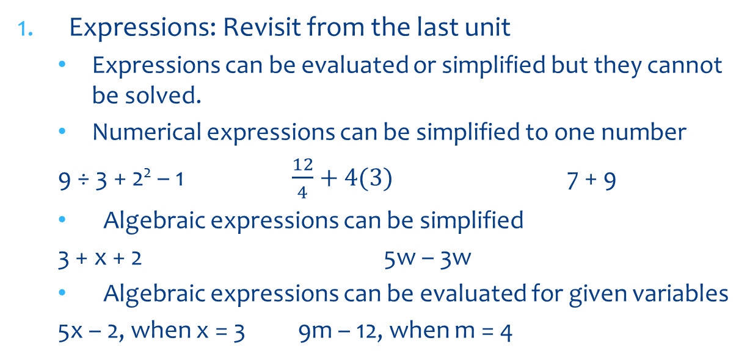
Expressions, Equation and Inequalities Notes
Expressions: Revisit from the last unit
  Expressions can be evaluated or simplified but they cannot be solved.
  Numerical expressions can be simplified to one number
  9 ÷ 3 + 2² – 1 $\frac{12}{4}+4(3)$ 7 + 9
  Algebraic expressions can be simplified
  3 + x + 2 5w – 3w
  Algebraic expressions can be evaluated for given variables
  5x – 2, when x = 3 9m – 12, when m = 4

Slide 9
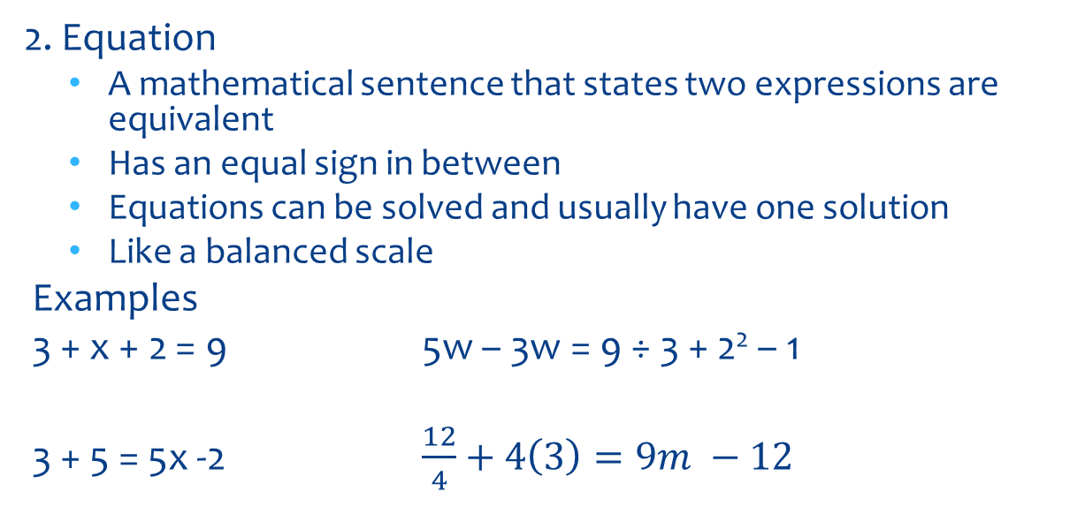
Notes Continued
2. Equation
  A mathematical sentence that states two expressions are equivalent
  Has an equal sign in between
  Equations can be solved and usually have one solution
  Like a balanced scale
Examples
3 + x + 2 = 9 5w – 3w = 9 ÷ 3 + 2² – 1
3 + 5 = 5x -2 $\frac{12}{4}+4\left(3\right)=9m −12$

Slide 10
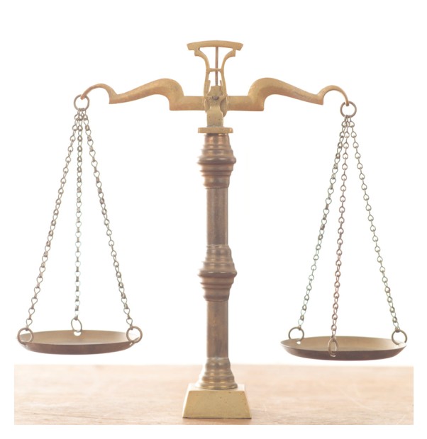
Equations
Like a balanced scale
=
3 + x + 2
9
What value of x would make this balance?

Slide 11
Equations
Like a balanced scale
=
3 + 5
5x - 2
Can you guess the value of x?

Slide 12
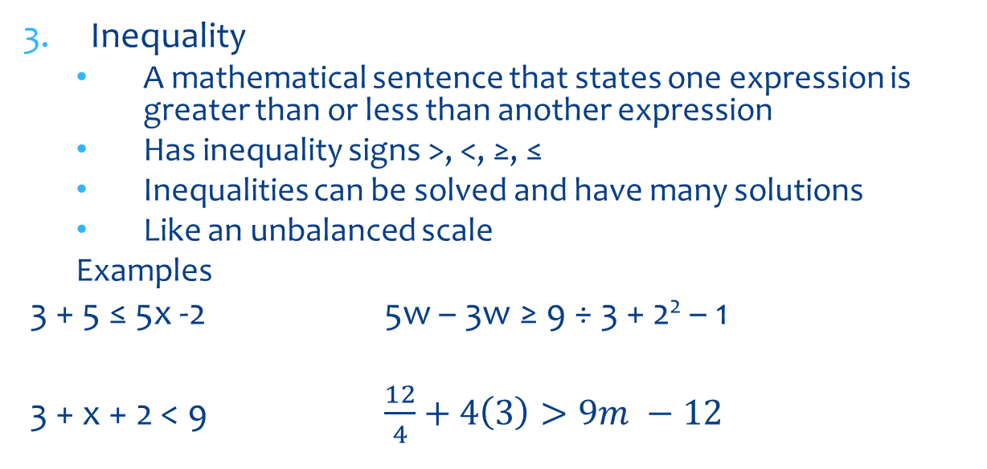
Notes continued
Inequality
  A mathematical sentence that states one expression is greater than or less than another expression
  Has inequality signs >, <, ≥, ≤
  Inequalities can be solved and have many solutions
  Like an unbalanced scale
  Examples
3 + 5 ≤ 5x -2 5w – 3w ≥ 9 ÷ 3 + 2² – 1
3 + x + 2 < 9 $\frac{12}{4}+4\left(3\right)>9m −12$

Slide 13
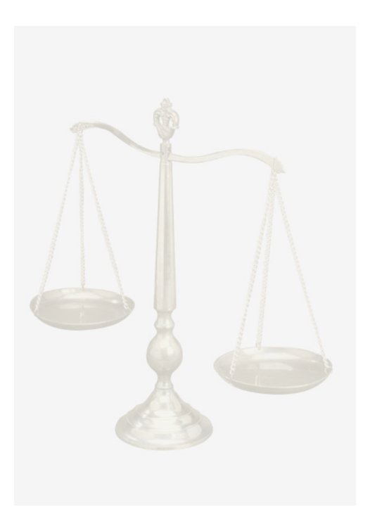
Inequalities
Like an unbalanced scale
3 + x + 2
<
9
Can you guess some possible values of x that make the statement true?

Slide 14

Challenge - Inequalities
Like an unbalanced scale
$$\frac{12}{4}+4(3)$$
>
9m - 12
Challenge Problem: Can you guess some possible values of m that make the statement true?

Slide 15
Language Arts Connection
Think of a word that completes this analogy
Expression is to Phrase as
equation or inequality is to ___________

Slide 16
Language Arts Connection
Think of a word that completes this analogy
Expression is to Phrase as
equation or inequality is to sentence!

Slide 17
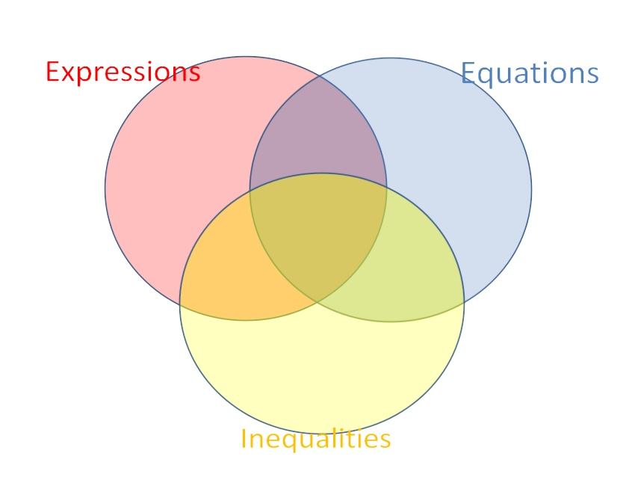
Put each characteristic to the appropriate spot in the Venn diagram
Has an equal sign
A mathematical phrase
A mathematical sentence
Can have numbers
Can be simplified
Like a balanced scale
Like a scale
Usually has one solution
Has no solutions
Cannot be solved
Can have +, -, x, ÷ signs
Has multiple solutions
Can have variables
Has >, <, ≥ or ≤ signs
Like an unbalanced scale
Can be solved

Slide 18
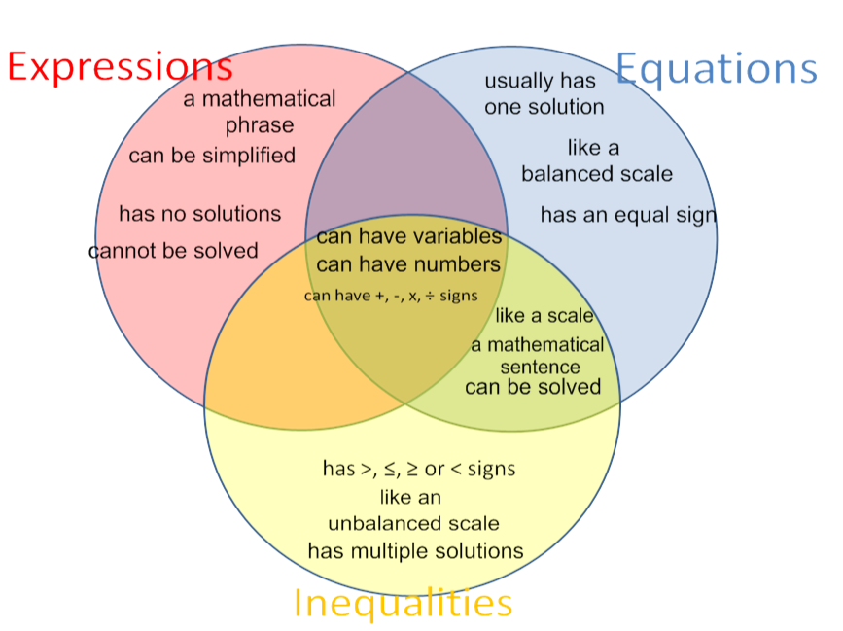
Solution

Slide 19
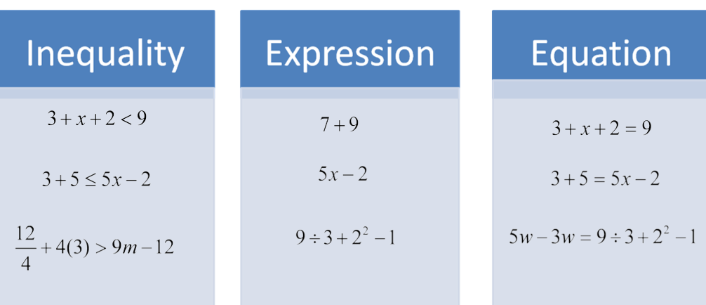
Card Sort
Let’s revisit the sorting card activity from earlier … did you have them all correct?

Slide 20
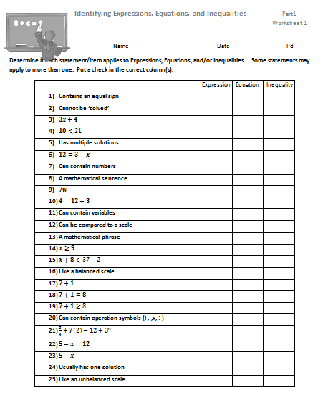
Practice
Complete the following worksheet

Slide 21
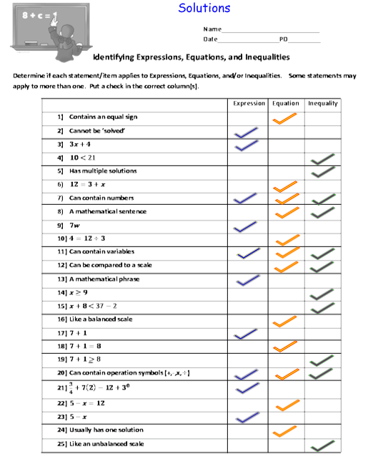

Slide 22
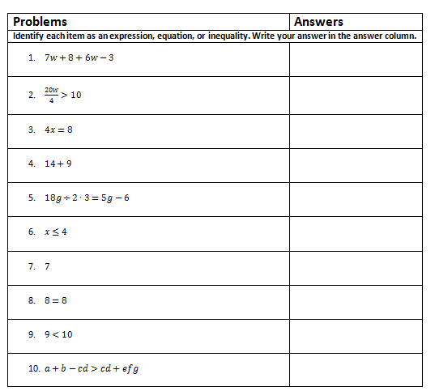
Part 1 Quiz
IDENTIFYING EXPRESSIONS, EQUATIONS, & INEQUALITIES

Slide 23
Reteaching
http://www.eduplace.com/math/mathsteps/3/d/3.represent.ideas.html
http://www.eduplace.com/math/mathsteps/3/d/3.represent.develop.html

Slide 24
Enrichment
Problem Solving Challenge

